Slide 1
SL
POWER BI • DATA ANALYTICS PROJECT
SUPPORTLYTICS
IT Support Analytics Dashboard
Project Name: SupportLytics
Tool: Microsoft Power BI
Domain: IT Support Analytics
Internship / Academic Project
Analyzing IT Support Ticket Data through KPIs and Interactive Visual Insights
SUPPORTLYTICS
1

Slide 2
OVERVIEW
Project Introduction
SupportLytics is an IT Support Analytics Dashboard developed using Microsoft Power BI.
The project focuses on analyzing IT support ticket data.
The dashboard converts raw support-ticket information into meaningful KPIs and visual insights.
It helps understand ticket volume, priority, status, resolution performance, customer sentiment, platforms, regions, product areas, issue types, and support clusters.
The dashboard contains two analytical pages, each focused on a distinct layer of analysis.
1
Page 1
SUPPORTLYTICS — IT Support Performance Overview
High-level KPIs and overall performance snapshot.
2
Page 2
SUPPORTLYTICS — Support Performance & Operational Analysis
Deeper operational and platform-level analysis.
SUPPORTLYTICS
Project Introduction
2
Notes:
SupportLytics is an IT support analytics dashboard built in Power BI. It converts raw ticket data into KPIs and visuals across two pages: an overview page and a deeper operational analysis page. Walk through the bullet points, then introduce both dashboard pages by name.

Slide 3
MOTIVATION
Problem Statement
THE CHALLENGE
HOW SUPPORTLYTICS RESPONDS
Large volumes of IT support tickets can be difficult to analyze manually.
Important information — priority, status, resolution time, region, platform, customer sentiment — is distributed across the dataset.
Manual analysis makes it difficult to quickly identify support workload and operational patterns.
A centralized analytical dashboard is required to provide a clear view of support performance.
Centralized dashboard
KPI monitoring
Interactive visual analysis
Multi-dimensional ticket analysis
Operational performance monitoring
SUPPORTLYTICS
Problem Statement
3
Notes:
Manually reviewing thousands of support tickets makes it hard to see workload and performance patterns. SupportLytics solves this with a centralized, interactive Power BI dashboard offering KPI monitoring and multi-dimensional analysis.

Slide 4
GOALS
Project Objectives
Analyze overall support ticket volume
Analyze similarity score
Analyze reopened tickets
Monitor high-priority tickets
Compare ticket volume across regions
Analyze customer sentiment
Monitor urgent tickets
Compare ticket volume across platforms
Analyze priority distribution
Analyze ticket status
Analyze product-area distribution
Build an interactive Power BI dashboard
Analyze average resolution time
Analyze issue-type distribution
Present support data through clear visualizations
Analyze customer satisfaction
Analyze support cluster distribution
SUPPORTLYTICS
Project Objectives
4
Notes:
SupportLytics defines seventeen objectives spanning ticket volume, priority, status, resolution performance, satisfaction, similarity scoring, regional and platform comparisons, product-area and issue-type distribution, clustering, reopened tickets, and sentiment — all delivered through an interactive Power BI dashboard.

Slide 5
DATA FOUNDATION
Dataset & Data Fields
Fields available in the Power BI Data pane:
ticket_id
Priority_Score
resolution_time_hours
has_attachment
product_area
Similarity_Level
initial_message
region
Similarity_Score
issue_type
reopened
sla_plan
platform
Resolution_Duration
status
priority
resolution_summary
customer_sentiment
KEY CALCULATED MEASURES
High Priority Tickets
Reopened Tickets
Resolution Rate
These fields and measures form the basis of every KPI and visualization used throughout the SupportLytics dashboard.
SUPPORTLYTICS
Dataset & Data Fields
5
Notes:
The Power BI data model includes eighteen fields such as ticket_id, priority, status, region, platform, and customer_sentiment, along with three calculated measures — High Priority Tickets, Reopened Tickets, and Resolution Rate. These are the building blocks behind every KPI and chart in the dashboard.

Slide 6
METHODOLOGY
Data Preparation & Analytical Approach
Raw Support Ticket Data
Data Preparation
Relevant Fields & Measures
Power BI Data Model
KPIs & Visualizations
Support Performance Analysis
Relevant ticket fields are used for analysis.
Numerical fields are used for KPI calculations.
Categorical fields are used for grouping and comparison.
Measures are used to calculate important performance indicators.
Power BI visuals are used to present the results interactively.
SUPPORTLYTICS
Data Preparation & Analytical Approach
6
Notes:
Raw ticket data flows through preparation into relevant fields and measures, is loaded into the Power BI data model, and finally surfaces as KPIs and visualizations that support performance analysis. Numerical fields drive KPI calculations while categorical fields power grouping and comparison.

Slide 7
PAGE 1 · HEADLINE METRICS
Key Performance Indicators
100K
38.99
2.24
Total Tickets
Average Resolution Time
Average CSAT
Overall volume of IT support tickets logged in the dataset.
Mean time taken to resolve a support ticket.
Mean customer satisfaction score across resolved tickets.
0.02
20K
5K
Average Similarity Score
High Priority Tickets
Urgent Tickets
Mean similarity between related/duplicate ticket content.
Tickets flagged as high priority requiring faster attention.
Tickets flagged urgent needing immediate response.
SUPPORTLYTICS
Key Performance Indicators — Page 1
7
Notes:
Page 1 opens with six headline KPIs: 100K total tickets, 38.99 average resolution time, 2.24 average CSAT, 0.02 average similarity score, 20K high-priority tickets, and 5K urgent tickets. These values are taken exactly as shown on the dashboard.

Slide 8
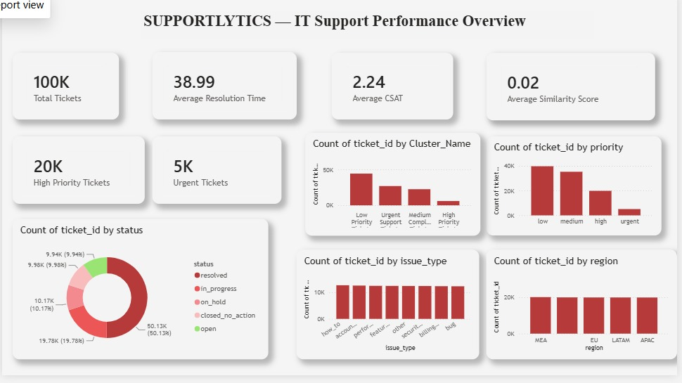
FULL DASHBOARD
Page 1 — IT Support Performance Overview
VISUALS ON THIS PAGE
Total Tickets
Average Resolution Time
Average CSAT
Average Similarity Score
High Priority Tickets
Urgent Tickets
Count of ticket_id by status
Count of ticket_id by region
Count of ticket_id by priority
Count of ticket_id by issue_type
Count of ticket_id by Cluster_Name
SUPPORTLYTICS
Page 1 — Dashboard Overview
8
Notes:
This is the complete Page 1 view: SUPPORTLYTICS — IT Support Performance Overview. It brings together six KPI cards and five charts covering status, region, priority, issue type, and support cluster, giving a full high-level snapshot of support performance.

Slide 9
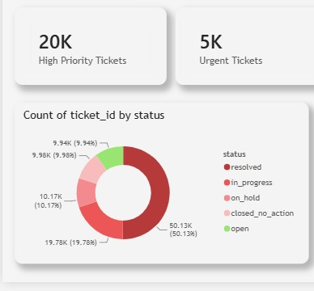
PAGE 1 · DETAIL
Ticket Status Analysis
STATUS CATEGORIES
resolved
in_progress
on_hold
closed_no_action
open
This visual shows how support tickets are distributed according to their current status — from newly opened tickets through to fully resolved cases.
SUPPORTLYTICS
Page 1 — Status Analysis
9
Notes:
The status donut breaks tickets into resolved, in_progress, on_hold, closed_no_action, and open. Resolved tickets make up the largest share at 50.13K, roughly half of all tickets, followed by in_progress at 19.78K.

Slide 10
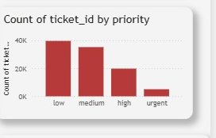
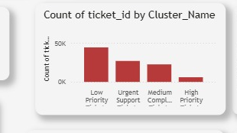
PAGE 1 · DETAIL
Priority & Support Cluster Analysis
Count of ticket_id by priority · Categories: low, medium, high, urgent
Count of ticket_id by Cluster_Name · Low Priority, Urgent Support, Medium Complex, High Priority
Priority analysis compares ticket workload across low, medium, high, and urgent levels.
Support cluster analysis groups tickets into Low Priority, Urgent Support, Medium Complex, and High Priority Ticket clusters, showing how workload concentrates across support groupings.
SUPPORTLYTICS
Page 1 — Priority & Cluster Analysis
10
Notes:
Priority is heavily weighted toward low and medium tickets, with fewer high and urgent cases. The Cluster_Name view shows Low Priority Tickets as the largest cluster, followed by Urgent Support, Medium Complex, and High Priority clusters.

Slide 11
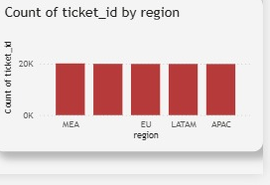
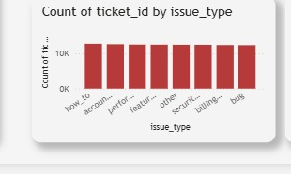
PAGE 1 · DETAIL
Regional & Issue-Type Analysis
Count of ticket_id by region · MEA, EU, LATAM, APAC
Count of ticket_id by issue_type · how_to, account, performance, feature, other, security, billing, bug
Region analysis helps compare support ticket distribution geographically across MEA, EU, LATAM, and APAC.
Issue-type analysis shows the types of support issues appearing in the dataset, spanning categories such as how-to, account, performance, feature, other, security, billing, and bug.
SUPPORTLYTICS
Page 1 — Regional & Issue-Type Analysis
11
Notes:
Ticket volume by region is fairly even across MEA, EU, LATAM, and APAC. Issue types are similarly distributed across how-to, account, performance, feature, other, security, billing, and bug categories.

Slide 12
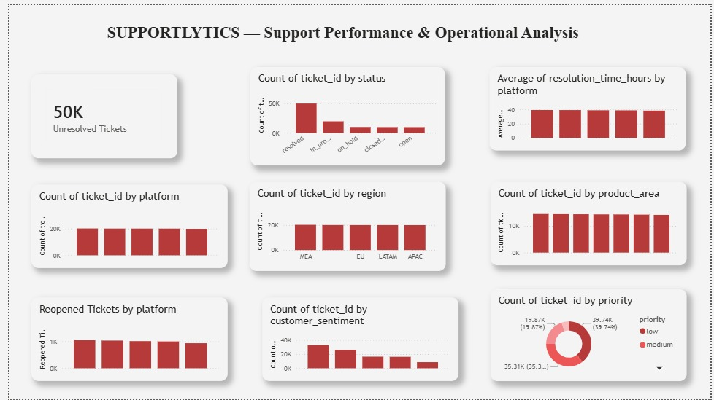
FULL DASHBOARD
Page 2 — Support Performance & Operational Analysis
VISUALS ON THIS PAGE
Unresolved Tickets (50K)
Count of ticket_id by status
Average of resolution_time_hours by platform
Count of ticket_id by platform
Count of ticket_id by region
Count of ticket_id by product_area
Reopened Tickets by platform
Count of ticket_id by customer_sentiment
Count of ticket_id by priority
SUPPORTLYTICS
Page 2 — Dashboard Overview
12
Notes:
Page 2, SUPPORTLYTICS — Support Performance and Operational Analysis, goes deeper into operational metrics: unresolved tickets, status, platform-level resolution time, region, product area, reopened tickets, sentiment, and priority.

Slide 13
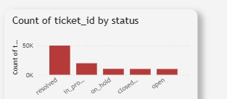
PAGE 2 · DETAIL
Unresolved Tickets & Status Analysis
STATUS CATEGORIES
resolved
50K
in_progress
on_hold
Unresolved Tickets
This section focuses on the current support workload and ticket-status distribution across the operational dataset.
closed_no_action
open
SUPPORTLYTICS
Page 2 — Unresolved & Status Analysis
13
Notes:
Page 2 highlights 50K unresolved tickets as a key operational figure, alongside the same five status categories seen on Page 1 — resolved, in_progress, on_hold, closed_no_action, and open — now viewed from an operational-workload perspective.

Slide 14
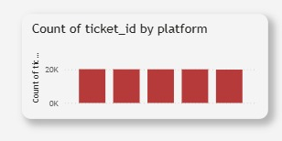
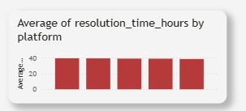
PAGE 2 · DETAIL
Platform Performance Analysis
Count of ticket_id by platform
Average of resolution_time_hours by platform
The first visual compares ticket volume across platforms.
The second visual compares average resolution time across platforms.
Together, they provide both a workload perspective and a resolution-performance perspective.
SUPPORTLYTICS
Page 2 — Platform Analysis
14
Notes:
Platform-level ticket counts are broadly even across the five platforms, and average resolution time in hours is also fairly consistent across them, suggesting no single platform is a major outlier in either workload or resolution speed.

Slide 15
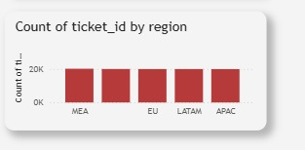
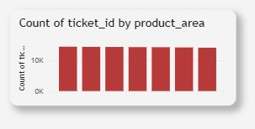
PAGE 2 · DETAIL
Regional & Product Area Analysis
Count of ticket_id by region
Count of ticket_id by product_area
Region analysis compares ticket distribution across geographic regions (MEA, EU, LATAM, APAC).
Product-area analysis identifies how tickets are distributed across different product areas.
SUPPORTLYTICS
Page 2 — Region & Product Area
15
Notes:
Regional ticket volume on Page 2 mirrors Page 1's distribution across MEA, EU, LATAM, and APAC. Product areas show relatively similar ticket volumes across the categories displayed in the chart.

Slide 16
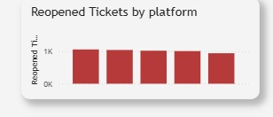
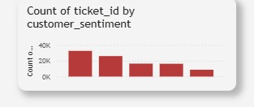
PAGE 2 · DETAIL
Reopened Tickets & Customer Sentiment
Reopened Tickets by platform
Count of ticket_id by customer_sentiment
Reopened-ticket analysis helps understand tickets that require additional support after initial resolution.
Customer-sentiment analysis shows the distribution of tickets according to customer sentiment categories.
SUPPORTLYTICS
Page 2 — Reopened Tickets & Sentiment
16
Notes:
Reopened tickets by platform are fairly evenly spread, indicating no single platform drives repeat support needs disproportionately. Customer sentiment is skewed toward the higher-count category on the left of the chart, tapering across the remaining sentiment bands.

Slide 17
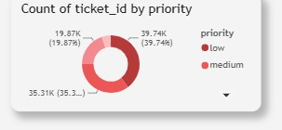
PAGE 2 · DETAIL
Priority Distribution
PRIORITY BREAKDOWN (PAGE 2)
low
39.74K (39.74%)
medium
35.31K (35.3%)
high / urgent (remaining share)
19.87K (19.87%) + balance
Categories shown: low, medium, high, urgent.
The visualization provides a comparison of support workload across priority levels.
SUPPORTLYTICS
Page 2 — Priority Distribution
17
Notes:
On Page 2, low-priority tickets account for 39.74K (39.74%) and medium-priority tickets for 35.31K (35.3%), with the remaining share split between high and urgent tickets at 19.87K (19.87%) for one of the visible segments — mirroring the low/medium-heavy pattern seen on Page 1.

Slide 18
DESIGN LANGUAGE
Dashboard Design & Visualization
Two-page dashboard structure separating overview from operational detail.
KPI cards for high-level monitoring at a glance.
Bar charts for clear category comparisons.
Donut charts for priority and status distribution.
Consistent visual layout across both pages.
Consistent red / maroon visual theme throughout.
Card-based dashboard design with soft rounded edges.
Clear separation between high-level and operational analysis.
Interactive Power BI environment enabling easy comparison between dimensions.
The dashboard was aligned and arranged to maintain consistent spacing and readability across both pages.
SUPPORTLYTICS
Dashboard Design
18
Notes:
Both pages share a consistent design language: rounded KPI cards, bar charts for comparisons, donut charts for distribution, and a unified red-maroon theme, with careful alignment and spacing throughout.

Slide 19
FINDINGS
Key Observations
Total ticket volume is approximately 100K.
High-priority tickets are approximately 20K.
Urgent tickets are approximately 5K.
Average resolution time is 38.99.
Average CSAT is 2.24.
Average similarity score is 0.02.
Page 2 shows approximately 50K unresolved tickets.
Ticket distribution can be compared across regions.
Ticket distribution can be compared across platforms.
Product areas have relatively similar ticket volumes in the displayed chart.
Low and medium priority tickets form larger portions than urgent tickets.
Status distribution shows resolved, in-progress, on-hold, closed/no-action, and open tickets.
Reopened tickets can be analyzed by platform.
Customer sentiment distribution adds a further dimension for understanding support interactions.
SUPPORTLYTICS
Key Observations
19
Notes:
These observations are drawn directly from the dashboard: roughly 100K total tickets with 20K high-priority and 5K urgent; a 38.99 average resolution time and 2.24 average CSAT; and clear comparative views across region, platform, product area, priority, status, reopened tickets, and sentiment.

Slide 20
IMPACT
Business & Operational Value
Faster monitoring of ticket workload
Identification of frequently occurring product areas / issues
1
6
Easier identification of high-priority and urgent tickets
Monitoring reopened tickets
2
7
Better visibility into unresolved tickets
Understanding customer sentiment
3
8
Comparison of resolution performance across platforms
Supporting data-driven operational decisions
4
9
Understanding regional ticket distribution
Providing a centralized reporting interface
5
10
SUPPORTLYTICS
Business & Operational Value
20
Notes:
SupportLytics gives IT support teams faster visibility into workload, priority, unresolved tickets, platform performance, regional patterns, product-area hotspots, reopened tickets, and customer sentiment — supporting more informed, data-driven operational decisions through one centralized reporting interface.

Slide 21
TOOLS
Technology & Tools
PB
PD
DM
VZ
Microsoft Power BI
Power BI Desktop
Power BI Data Model
Power BI Visualizations
DX
FL
FM
DAX / Measures
Filters & Interactions
Fields & Calculated Measures
SUPPORTLYTICS
Technology & Tools
21
Notes:
The project was built entirely in Microsoft Power BI Desktop, using the Power BI data model, DAX-based measures, native visualizations, and interactive filters across the defined fields and calculated measures.

Slide 22
WRAPPING UP
Conclusion
SupportLytics transforms IT support ticket data into an interactive analytical dashboard.
The dashboard provides both high-level KPIs and detailed operational analysis.
Page 1 focuses on overall IT support performance; Page 2 focuses on detailed support operations.
The project covers ticket volume, status, priority, resolution time, CSAT, similarity score, platform, region, product area, issue type, support clusters, reopened tickets, and customer sentiment.
Power BI provides an effective way to visualize and analyze support-ticket data, making complex information easier to understand and communicate.
THANK YOU
SUPPORTLYTICS
22
Notes:
SupportLytics turns raw IT support ticket data into an interactive Power BI dashboard combining high-level KPIs on Page 1 with detailed operational analysis on Page 2, covering the full range of ticket dimensions. Thank the audience and invite questions.

